Slide 1
Cross-Platform Mobile Application Development with Xamarin
Module 3, Lesson 5:
Developing Android Apps with Xamarin (Part 2)
Notes:
Images and excerpts from Xamarin Mobile Application Development by Dan Hermes, published by Apress
http://www.mobilecsharpcafe.com/xamarin-book/

Slide 2
Topics
Coding for Android using C#
Android development fundamentals:
ListView
Managing State
Resources
Android user interfaces

Slide 3
Objectives
In this lesson you will learn about:
Building an Android application using Xamarin.Android
Basic Android development concepts
User interfaces on the Android platform

Slide 4
Basic Xamarin.Android Concepts

Slide 5
Android ListView
ListView is bound to an array or a data model using an Adapter.
There are two ways to create a ListView:
Use the ListActivity class, which is an Activity containing a ListView
Use the ListView tag in a layout XML, often used for customizing a list
Notes:
Notes:
ListView is a view group that displays a scrollable list of items. ListViews are bound to an Array, List, or data model using an Adapter.
They contain several built-in views containing one or two lines of text and an image.
Custom views can be constructed using LinearLayout at the expense of performance.
Used in its basic form, ListView is simple and fast.

Slide 6
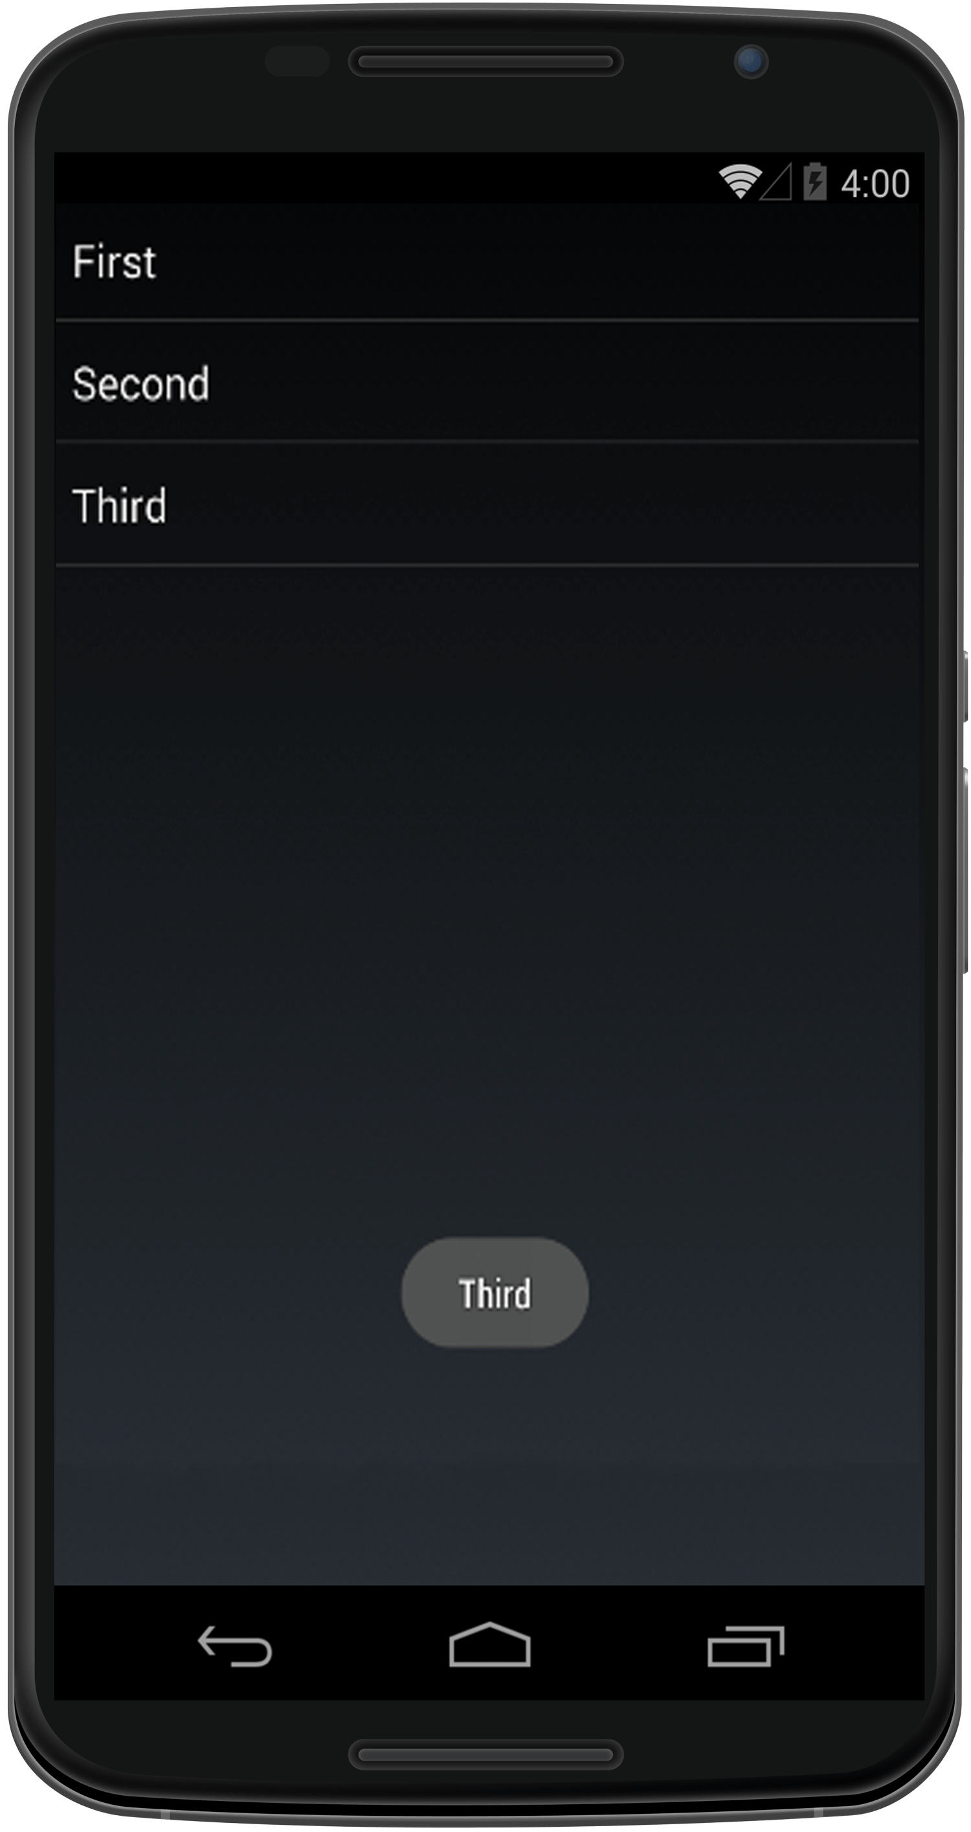
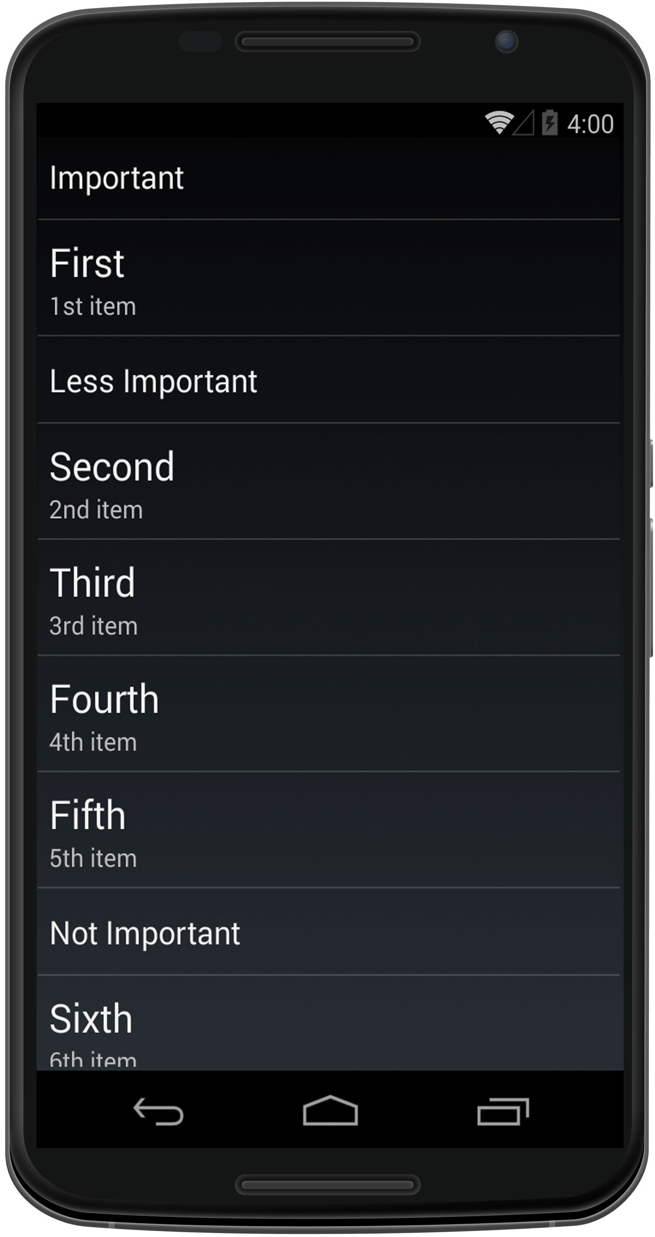
ListViews
Notes:
References:
Images from Xamarin Mobile Application Development by Dan Hermes http://amzn.to/1rowG7K

Slide 7
Place a ListView in a Layout
<?xml version="1.0" encoding="utf-8"?>
<LinearLayout xmlns:android="http://schemas.android.com/apk/res/android"
android:orientation="vertical"
android:layout_width="fill_parent"
android:layout_height="fill_parent">
<ListView
android:minWidth="25px"
android:minHeight="25px"
android:layout_width="match_parent"
android:layout_height="wrap_content"
android:id="@+id/listItems" />
</LinearLayout>

Slide 8
ListView Using ListActivity
public class MainActivity : ListActivity
{
string[] listItems;
protected override void OnCreate(Bundle bundle)
{
base.OnCreate(bundle);
listItems = new string[] { "First", "Second", "Third"};
ListAdapter = new ArrayAdapter<String>(this, Android.Resource.Layout.
SimpleListItem1, listItems);
}
}
Notes:
Notes:
Here you bind the list to an ArrayAdapter referring to the array of string’s listItems using the
ListActivity’s ListAdapter property. SimpleListItem1 is a built-in view containing one heading per row.
We will discuss other built-in layouts later.

Slide 9
ListView: Selecting an Item
protected override void OnListItemClick(ListView l, View v, int position, long id)
{
String SelectedItem = listItems[position];
Android.Widget.Toast.MakeText(this, SelectedItem,
Android.Widget.ToastLength.Short).Show();
}
Notes:
Notes:
User selection of a list item is handled by overriding the OnListItemClick method in the ListActivity.
The selected item index is passed in through the parameter called position.
Touching a list item will now cause a toast to appear and display the Title of the ListItem

Slide 10
Populating a ListView
There are two common ways to populate a ListView.
ArrayAdapter
Data Model

Slide 11
ListView from an ArrayAdapter
public class ListActivityArray : ListActivity
{
string[] listItems;
protected override void OnCreate(Bundle bundle)
{
base.OnCreate(bundle);
listItems = new string[] { "First", "Second", "Third" };
ListAdapter = new ArrayAdapter<String>(this, Android.Resource.Layout.SimpleListItem1, listItems);
}
}

Slide 12
ListView from a Data Model
Data Model - Create a data model containing the list items.
Adapter - Create a custom list adapter to determine which fields to display in the list.
Activity - Populate the custom class and pass it into the custom list adapter constructor.
Assign the adapter to the ListActivity.ListAdapter.

Slide 13
Create a Data Model
public class ListItem
{
public string Title { get; set; }
public string Description { get; set; }
}

Slide 14
Create an Adapter
public class ListItemAdapter : BaseAdapter
{
private List<ListItem> itemList;
private Activity context;
public ListItemAdapter(Activity context, List<ListItem> items) : base()
{
this.context = context;
this.itemList = items;
}
// also implement Count, GetItem, and GetItemId
public override View GetView(int position, View convertView, ViewGroup parent)
{
View view = convertView;
if (view == null)
view = context.LayoutInflater.Inflate(Android.Resource.Layout.SimpleListItem1, null);
view.FindViewById<TextView>(Android.Resource.Id.Text1).Text = itemList[position].Title;
return view;
}
}
Notes:
Notes:
Also needed:
public override int Count
{
get { return itemList.Count; }
}
public override Java.Lang.Object GetItem(int position)
{
throw new NotImplementedException();
}
public override long GetItemId(int position)
{
return position;
}

Slide 15
Create an ListActivity
public class MainActivity : ListActivity
{
List<ListItem> listItems;
protected override void OnCreate(Bundle bundle)
{
base.OnCreate(bundle);
List<ListItem> listItems = new List<ListItem> {
new ListItem {Title = "First", Description="1st item"},
new ListItem {Title = "Second", Description="2nd item"},
new ListItem {Title = "Third", Description="3rd item"}
};
ListAdapter = new ListItemAdapter(this, listItems);
}
}

Slide 16
ListView Selection
protected override void OnListItemClick(ListView l, View v, int position, long id){
String SelectedItem = listItems[position];
Android.Widget.Toast.MakeText(this, SelectedItem, Android.Widget.ToastLength.Short).Show();
}
Notes:
Notes:
Place OnListItemClick method in ListActivity

Slide 17
Cell Reuse: It’s Faster
public override View GetView(int position, View convertView, ViewGroup parent){
view view = convertView;
if (view == null)
view = context.LayoutInflater.Inflate( Android.Resource.Layout.SimpleListItem1, null);
view.FindViewById<TextView>(Android.Resource.Id.Text1).Text = itemList[position].Title;
return view;
}
Notes:
Notes:
This code attempts to use existing View rows before constructing new ones.
It is important to code for performance, which means cell reuse when possible. The GetView of the adapter constructs each row of the list as needed. The View parameter contains an existing row, if one exists. This should be used if possible. If it is null, then a new row must be created, using the Inflate method.

Slide 18
Starting Activities: Intent
Start New Activities Using Intents
Intent intent = new Intent(this, typeof(IntentToActivity));
StartActivity (intent);
Abbreviate to this:
StartActivity(typeof(IntentToActivity));
Notes:
Notes:
Intents create and navigate to new screens on Android. Instantiate an intent with the parameter of the desired new activity, and then call the Activity.StartActivity method, passing in the intent.

Slide 19
Managing State: Bundle
Transfer data between Activities inside a Bundle
Similar to Session variables that are Activity-specific
Accessible in the OnCreate event
Destroyed in the OnDestroy event
Can be saved in OnSaveInstanceState event
Most common use is in the Intent
Notes:
Notes:
Intents have built-in bundles.

Slide 20
Packing Intents
Intent intent = new Intent(this, typeof(SecondActivity));
intent.PutExtra("click_count", count);
StartActivity(intent);
Notes:
Notes:
AdvancedAppLifecycleDemos - AppInstance

Slide 21
Unpacking Intents
CounterText.Text = Intent.GetIntExtra(“myKey", 0).ToString();
OR
Bundle extras = intent.getExtras();
String tmp = extras.getString("myKey");

Slide 22
Android Resources
Directory | Contents
Layout | User interface XML files
Drawable | Images
Values | Localization files
Notes:
References:
Android resources: https://developer.xamarin.com/guides/android/application_fundamentals/resources_in_android/

Slide 23
Using Android Resources
Resources.designer.cs
Generated file
Located in Resources directory
Resources directory items represented by integers
Notes:
Notes:
Generated files are regenerated frequently.
Changes by the developer are subject to be overwritten.

Slide 24
Using Android Resources
Drawable/Layout directories
Resources.[directory].[file name without extension]
Layout item IDs
In .axml file: <Button android:id="@+id/MyButton”
Resource.Id.MyButton
Strings
In .axml file: android:text="@string/Hello”
Resource.String.Hello
Notes:
Notes:
Providing different layouts for different screen sizes may sometimes be necessary, it is supported in Xamarin…
References:
More information on different size layouts: https://developer.xamarin.com/guides/android/application_fundamentals/resources_in_android/part_4_-_creating_resources_for_varying_screens/#Provide_Alternate_Layouts_for_Different_Screen_Sizes

Slide 25
Android Manifest
Pulls together everything to explain it to the Android OS
Represented as a form in a tab of the project properties
Notes:
Notes:
Right-click the Android project and select “Properties.”
Click “Android Manifest” on the left-hand menu
Reference:
Android Manifest in Xamarin: https://developer.xamarin.com/guides/android/advanced_topics/working_with_androidmanifest.xml/

Slide 26
Summary
In this lesson you have learned to:
Use ListView
Manage States
Use Resources
Notes:
Notes:
The Module 3 Lesson 5 Lab should be completed at this time:
https://github.com/MSFTImagine/computerscience/tree/master/Complimentary%20Course%20Content/Module3/Labs

